Slide 1
AMAZON SELLER APP
BY ADNAN MAJEED
INSTRUCTOR IT : COMPUTER LEARNING CENTER LAHORE

Slide 2
What is the Amazon Seller app?
The free Amazon Seller app is packed with features that help you manage and grow your Amazon seller account wherever you are. It gives you the freedom to take care of business without being tied to a desk or an office. Ecommerce business owners commonly struggle with:
Spending too much time trying to find third-party tools to keep track of sales and listings
Needing to be on-site to manage orders and inventory or change a product price quickly
Staying on top of customer reviews, requests, and questions
Have you experienced challenges like these? Do you wish you could get instant notifications for urgent matters wherever you are? Using the Amazon Seller app can help you:
Save time with quick and easy access to sales, listings, and other store features
Manage inventory and product prices remotely
Improve store performance by keeping up with customer reviews and requests
The Amazon Seller app sends instant notifications so you can resolve issues as they arise and minimize any disruptions to your ecommerce business.

Slide 3
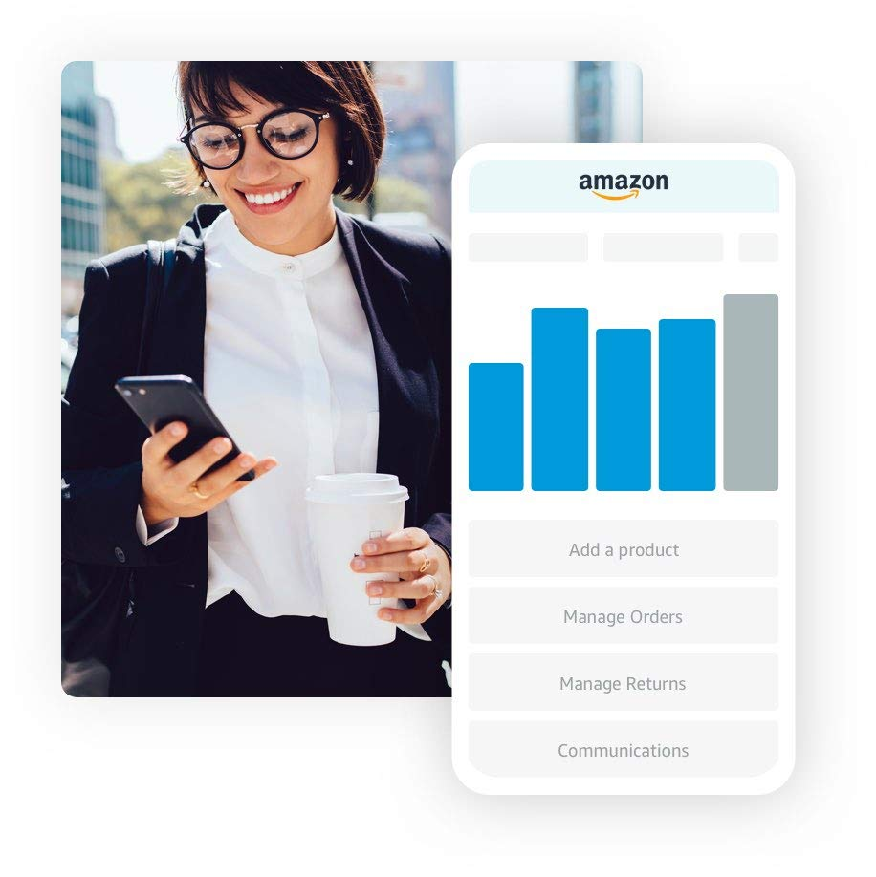
Amazon

Slide 4
Did you know?
Amazon supports small businesses with tools, insights, and data
Amazon has invested tens of billions in infrastructure and built hundreds of tools and free resources to help independent sellers succeed on Amazon—including data analytics to help independent sellers better understand and reach customers.

Slide 5
10 benefits of using the free Amazon Seller app
The benefits of using this ecommerce tool are many—and growing. With the Amazon Seller app, you can:
Analyze sales
Fulfill orders
Find products to sell
Manage offers, inventory, and returns
Respond to customer messages quickly
Stay current with inventory and pricing alerts
Manage Sponsored Product campaigns
Access product-level inventory details
Easily research and sell products
Create listings and edit professional-quality product photos

Slide 6
The Amazon Seller app can improve business performance
By actively using the ecommerce app, sellers may earn more sales by earning a higher store rating, having a lower account suspension rate, and having the ability to respond faster to buyer messages

Slide 7
App features for running your ecommerce business remotely
You can use the Amazon Seller app to search for and find products to sell. Whenever inspiration strikes you, the visual search feature scans products with or without a barcode and instantly helps you discover details about products listed in Amazon stores.
Here are more ways you can use the tool to streamline your business operations:
Create product listings
Add offers to existing listings or create new catalog products to sell.
Use your mobile device’s camera to scan barcodes, take product photos, and upload documents.

Slide 8
Edit product photos for free
Avoid expensive product photo sessions and rejected images.
Capture, retouch, edit, and submit professional-quality product photos using the Product Photo Studio.
Know if images meet Amazon requirements and fix issues before you submit.

Slide 9
Manage product inventory
Navigate product-level inventory details.
Get aggregated analytics and information.
Optimize inventory decisions and check the status of fulfillment channels.
View Fulfillment by Amazon (FBA) inbound statistics or status statistics.
Make Merchant Fulfilled Network (MFN) quantity changes.

Slide 10
Manage pricing
Get product-level pricing details and make pricing changes and updates.
Get a “fee preview” of a product--estimated fees if the product is sold.
View low price match and Featured Offer price.
View competitor offers.
Use the profitability calculator to estimate product margin, which tells you how much the product sells for above the actual cost of the product itself.

Slide 11
Fulfill orders
Receive push notifications to know when products sell.
View pending orders and account status updates.
Manage returns and issue refunds.
If you use FBA to outsource order fulfillment, you can check the status of FBA shipments.
Get shipment updates to make sure orders are in process, in transit, or completed.

Slide 12
Track and analyze sales
Get a quick status update by tracking sales and keeping an eye on sales growth.
Drill down into product-level sales over time.
View top-selling products.
Use charts to track year-to-date sales performance and sales by date range.
Compare performance to past years and monitor key performance indicators.

Slide 13
Stay on top of customer service and engagement
Get instant notifications when customers inquire about products.
Use the Seller Feedback Manager to manage and post public replies to customer feedback.
Check messages and use customizable email templates to reply to common questions.
Share products on social media with one tap.

Slide 14
Manage promotions
Special Deals: Monitor deal performance on the Deals Dashboard, tracking the performance of Lightning Deals and 7-Day Deals.
Sponsored Products: Manage and make adjustments to Sponsored Products campaigns.
Track ad spend, impressions, and average cost-per-click (CPC) of all campaigns in a preferred time range.
Update daily budget for each campaign and modify keyword settings.
Edit ad groups to organize by a common theme. Modify ad campaigns and keywords to tailor them to your target audience.
Update bids and pause individual campaigns.

Slide 15
Leverage additional management tools
Account Health: Keep an eye on essential metrics in one place with the Account Dashboard. Get visibility into your account’s adherence to Amazon’s performance targets and policies.
Get visibility into service performance metrics such as Order Defect Rate, Cancellation Rate, Late Shipment Rate, Valid Tracking Rate, On-time Delivery Rate, and Return Dissatisfaction Rate.
Monitor product policy compliance with complaints or violation tracking.
See top banner alerts if your account is at risk of deactivation or if it has been deactivated, and one click will list reasons for account status.
User Permissions: Share access with your team and control user permissions. Whether they sign in using the app or a computer, users have identical access to their Seller Central accounts with the same user rights and roles as they have with the Seller Central website.
International Sales: Manage global business efficiently with a single sign-in. One-tap country switch and business.
Seller Support: Quickly send questions to the Seller Support team. Reply to ongoing support cases via case log and resolve issues efficiently.

Slide 16
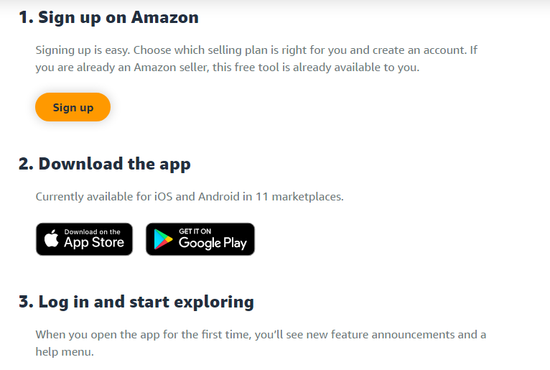
How to get the Amazon Seller app

Slide 17
FAQ
Is there an app for Amazon sellers?
Yes. Amazon Seller is Amazon’s free mobile app that helps you manage your Amazon business remotely. Once you choose a selling plan and register, you can download the Seller app from the Apple Store or Google Play.

Slide 18
What is the Amazon Seller app?
Amazon Seller is Amazon’s free mobile app that helps you manage your ecommerce business from anywhere. This ecommerce app gives you the power to handle business details conveniently from your mobile device.
Along with other features, you can use it to:
Track and fulfill orders
Search and find products to sell
Manage pricing, offers, inventory, and returns
Stay on top of customer service and respond to customer messages quickly
Stay current with inventory and pricing alerts
Manage Sponsored Product campaigns and access product-level inventory details
Easily create listings and edit professional-quality product photos
Analyze sales over time and manage campaigns
Set up instant notifications

Slide 19
How do I use the Amazon Seller app?
To use this free ecommerce app, first set up a seller account. Then download the app from the Apple Store or Google Play. When you set it up, it syncs with your Amazon seller account, and helps you manage business details from anywhere with an internet connection.

Slide 20
How much does the Amazon Seller app cost? Is the Amazon Seller app free?
The Amazon Seller app is free. Download the app from the Apple Store or Google Play. Once you log in, you can manage business details right from your mobile device.

Slide 21
Are there any free tools for Amazon sellers?
Yes, many free tools for Amazon sellers are designed to help small- and medium-sized businesses grow. Amazon has invested tens of billions in infrastructure and built hundreds of tools and free resources to help independent sellers succeed in Amazon stores—including data analytics to help independent sellers better understand and reach customers.
Go mobile with the Amazon Seller app, available on Apple Store or Google Play. The tool gives you the power to handle business details conveniently from your mobile device.

Slide 22
What are some useful apps for Amazon sellers?
Amazon sellers have many valuable tools at their fingertips. For example, Amazon Seller is Amazon’s free ecommerce app that helps you manage an Amazon store. The Amazon Partner Network is an excellent place to find automated solutions to manage and grow your business, available from external developers and Amazon. Browse hundreds of tech solutions filtered by category, reviews, pricing, language, and more.

Slide 23
How easy is it to sell products on Amazon?
Entrepreneurs are creators, using their ideas to start, build, invent, and experiment. Amazon works to support and empower businesses through resources, learning tools, logistics, services, and programs. Tools like Seller University training videos and Seller Central Forums exist to help you learn how to manage inventory, handle order fulfillment, and grow your ecommerce business. If you want to sell products on Amazon, here’s the rundown of how to get started:
Choose between an Individual or Professional selling plan
Create an account
List products
Fulfill orders
Make money
If you’re starting a new ecommerce business, and have a Professional seller account, Amazon offers even more free tools and resources to help you along the way, including the Amazon Seller app (available on Apple Store or Google Play). Need a little inspiration? Check out this list of 38 business ideas to see real-life examples of sellers who’ve built a business selling online.

Slide 24
How to use the Amazon Seller app
https://sell.amazon.com/blog/how-to-use-amazon-seller-app
Video link

Slide 25
How does the Amazon Seller app work?
The Amazon Seller app is a software solution that allows you to manage an Amazon store from your mobile device. After you create an Amazon Seller account, you can download the app for free and set up push notifications to stay on top of important tasks. Use the app’s features to conveniently list products, keep an eye on sales, fulfill orders, respond to customers, and more

Slide 26
Q:How do you scan products using the Amazon Seller app?
Select the camera icon on the app home screen or select Add a Product to get started. Use your device’s camera to scan the product’s barcode, or let the AI find a product for you using an image search.

Slide 27
How can you scan books on the Amazon Seller app?
You can scan a book using the app’s handy Add a Product feature. Use the manual search bar to look up a book by title, or scan its barcode using the visual search option, which will pull up product details in the Amazon catalog.

Slide 28
How can you download the Amazon Seller app on a laptop?
The Amazon Seller app is a mobile app available for iOS and Android. On a laptop or desktop device, you can navigate directly to Seller Central in a browser window, so there’s no need to download the app. Here are some options to download the app for your mobile device:
For iPhone users: Click here, or search for “Amazon Seller” on the iOS app store.
For Android users on Fire OS: Click here, or search for “Amazon Seller” on the Amazon app store.
For Google Play appstore: Click here, or search for “Amazon Seller” on the Google Play app store.
For Android users in mainland China: Download the app by searching for “亚马逊卖家” in Tencent app store (腾讯应用商店）
You can also scan a QR code on the footer of the Seller Central homepage to get the app on your mobile device.

Slide 29
Can I use the Amazon Seller app to do business in regions outside of the U.S.?
The Amazon Seller app is available in 20+ countries and over 13 languages via single sign-on, allowing you to shift seamlessly between countries and regions in which you do business. Learn more in this guide for global selling.

Slide 30
Respond to customer needs and feedback
Use the Seller app to connect with customers and convert visitors into loyal return buyers. The app allows you to view customer feedback and reply to messages.
Tap the Communications icon on your home screen to access messages. You can see and quickly respond to messages, or mark them as “reply not needed.”
Filter to find messages you haven’t yet replied to.
Use keywords to search your inbox for specific messages.
Customize email templates to save time responding to common queries.
You can also leave public responses using the Feedback Manager, where you can view ratings over time along with customer reviews.
Share the app with other members of your team to help keep up with messages and other tasks as you scale. Set up user permissions in Seller Central to manage access.

Slide 31
Review sales performance and monitor orders
Get a picture of sales performance with clear metrics and sales data for your business right in the app. Simply tap the sales chart to see sales, spot best sellers, and start identifying trends. Tap again to get information about product-level sales over time.
You can toggle between product sales and units sold using the gear icon. Filter data by date range—the past seven days, 30 days, or the current week or month.

Slide 32
To review payment details and current or past statements, tap the Payments tab on your home screen. In addition to statements, you can also view information about:
Refunds
Current orders
Other transactions
The app also gives you oversight for the entire fulfillment process—from the moment customers place orders to the point when the packages arrive at their doorsteps. Keep an eye on the returns process as well as:
On-time deliveries
Late shipment stats
Order defect rates
Cancellation numbers
Return dissatisfaction data

Slide 33
Maintain account health
It can be tedious to comb through policy details to ensure your account is meeting performance requirements. The ability to see potential problem areas can help you nip issues in the bud.
To access the dashboard and view metrics about product complaints and performance, tap the Account Health option on the home screen.
Get instant insights into areas you may need to focus on to make store improvements.
Find up-to-date information about policy updates and news from Amazon by tapping the News tab.
Tap banner on the home screen to learn the details about critical issues that might put your account at risk.

Slide 34
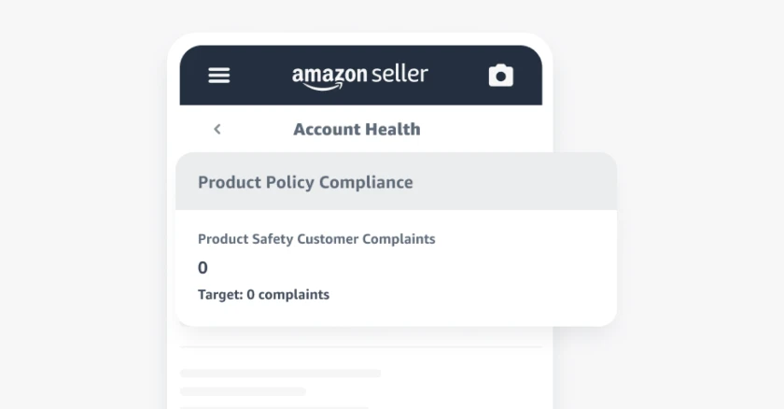

Slide 35
Ali EXPRESS DISCOUNTED PRODUCT TO BUY AND SELL ON AMAZON
MEN BELT LEATHER = 1400 PKR
AMAZON MEN BELT LEATHER 32$ = 8559
ALI EXPRESS BUY
RESALE ON AMAZON AND EARN 7159 PKR
RETURN ON INVESTMENT CASH

Slide 36
PACKING MATERIAL (OWN)
1. PACKING
2. LABELING
3. TAGGING
4. PRICING TAG
--------------------------------------
BAR CODE APP (DOWNLOAD )
PRODUCT SCAN ( GENERATE BAR CODE)
PRINT THEM AND LABEL THEM
--------------------RESALE ON AMAZON
1. DISCOUNTED WEBSITE
OLX.COM.PK
DARAZ.PK
2. RESELL ON AMAZON

Slide 37
Thanks

